Slide 1

Skin Disease Classifier Using Deep Learning
Tushar Kumar
2K19/CO/413
Tanmay Gupta
2K19/CO/406
Database management System
Data Mining Project

Slide 2

1. Dataset 2. Data Cleansing 3. Model Implementation 4. Model Training 5. Deployment
About
6. Preparing Frontend and Backend 7. Deploying on a Website
8. Database for additional details 9. Make Predictions
10. References

Slide 3

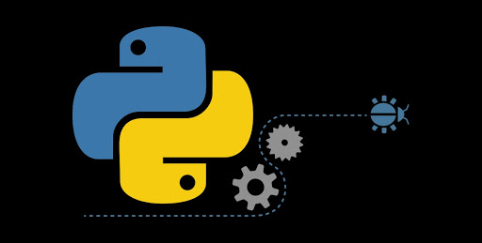
Introduction
Using Python
This project is made in python completely.
Deep learning Architecture (CNN).
Backend in Python using Python-Flask.
the basic idea is to implementing a Deep network which can predict the type of skin infection.

Slide 4
Dataset And Cleansing
Work on data step by step
There were 23 diseases in the dataset before.
Now there are 18 diseases because samples picture of those 5 diseases were such a waste like some body scan, x-rays, etc.
Deleted those folder.
Cleaned other samples pictures.
Selected some pictures from each folder which were appropriate for training to get better result.
Performed same steps for Test dataset.
We got this dataset from one of the Kaggle’s challenge, where the highest accuracy was around 20%.

Slide 5
Model architecture and Hyper-parameters-tuning
Convolutional Neural Network
Hyper-Parameters
One of the most popular Neural Network in Image Classification and Detection Tasks.
Convolutional layer, pooling layer, Activation and Batch Normalization.
Fully connected Neural Network which produces output.
Hyper-parameter are the parameters that are independent of Data.
Stride, Pool, Filters, etc.
Learning rate, gamma, beta etc.

Slide 6
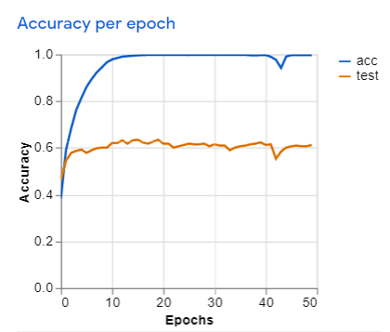
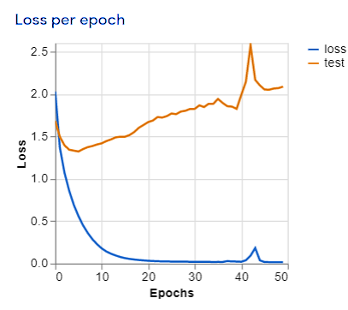
Accuracy And Loss Chart
Blue line showing accuracy and loss per epoch during training where orange line represents the accuracy and loss per epoch during test.

Slide 7
Deploying Our Trained model
After completion of training of our model and we have saved it using Keras API. So now we can use that saved model anywhere like in Android application, Computer Software, Website, etc.
We have chosen Website to develop our project because :
To provide it free of cost and for better reach to people.
To save time of user.
No headache like installation and no space requirement.

Slide 8
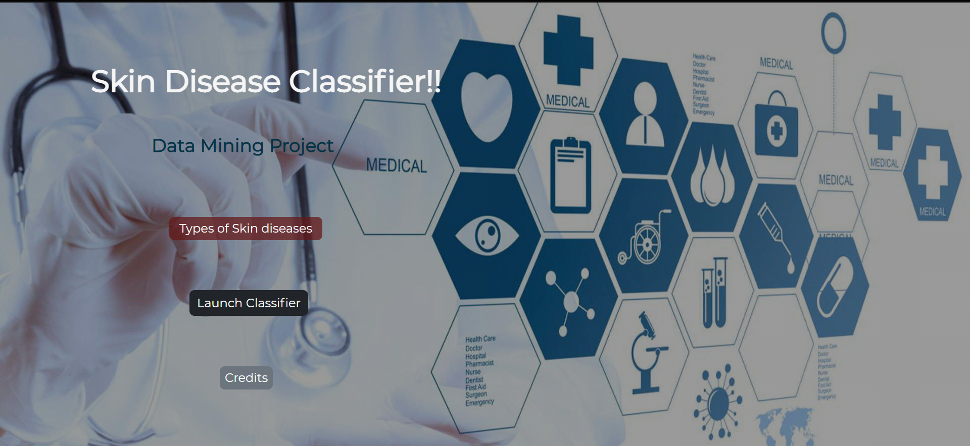
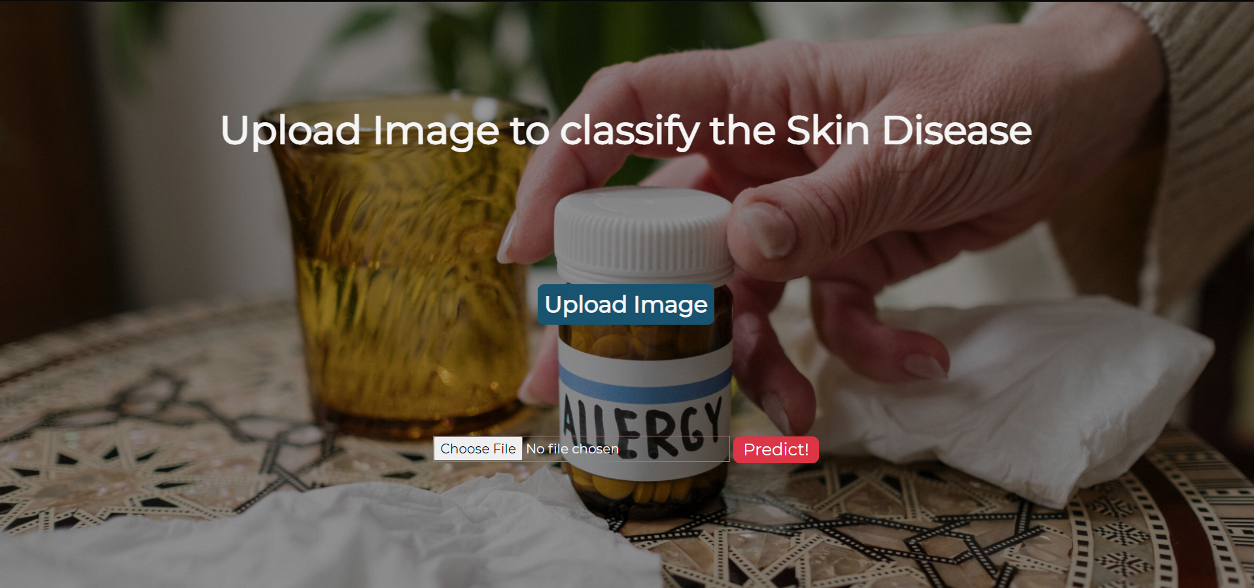
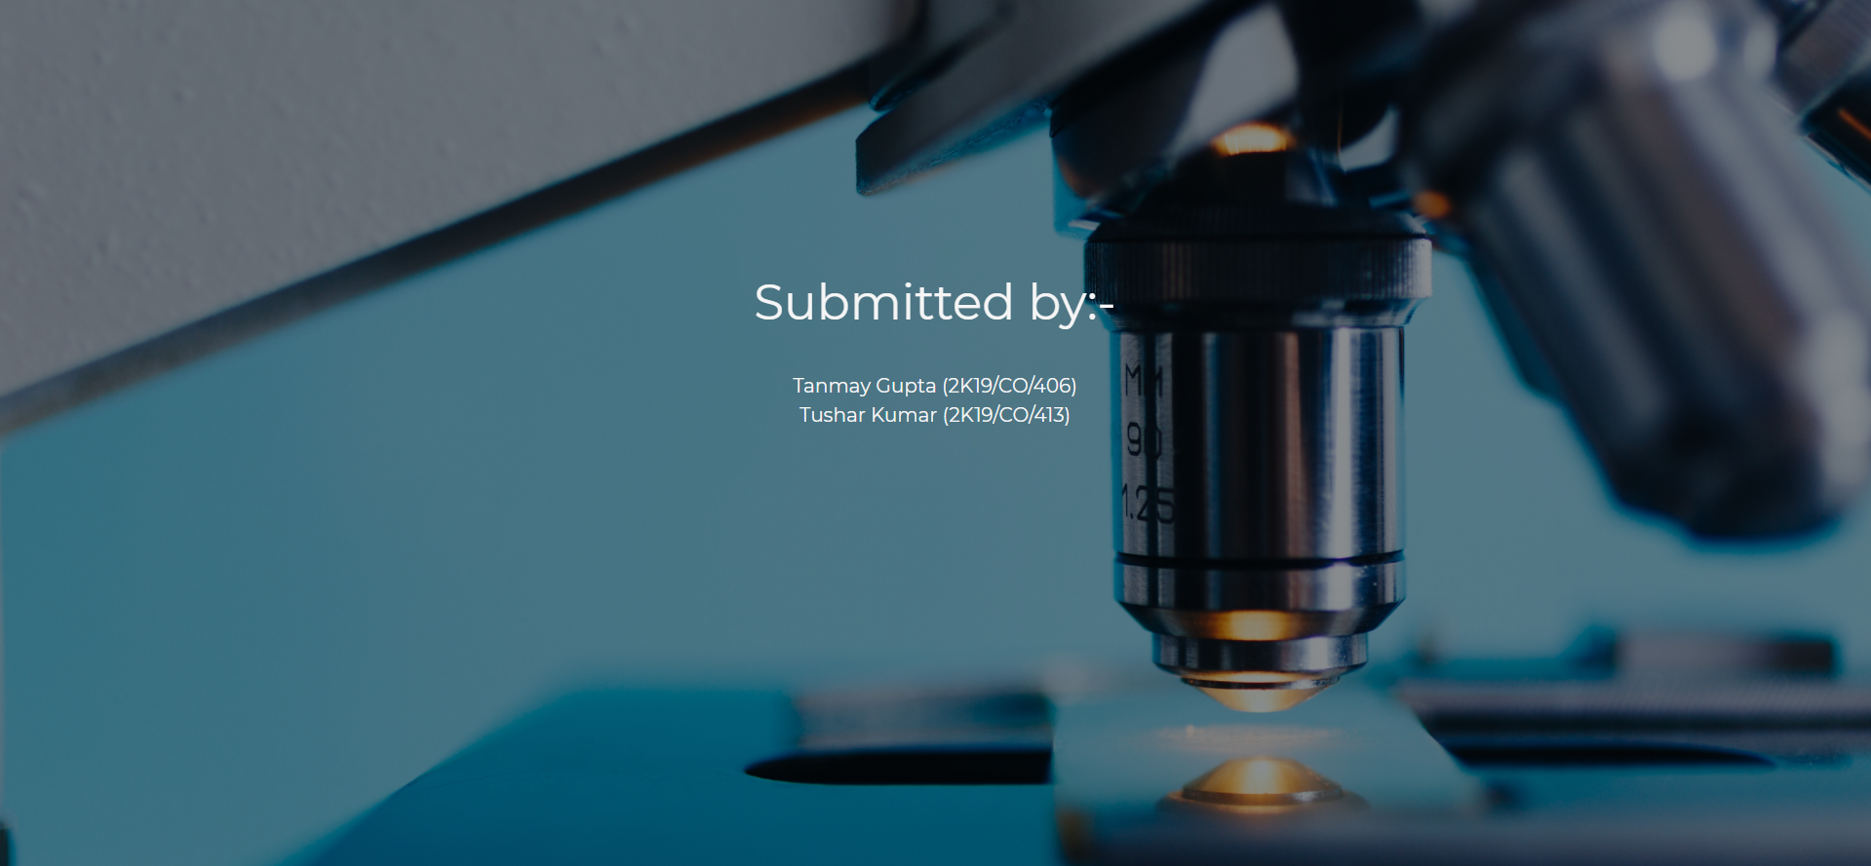
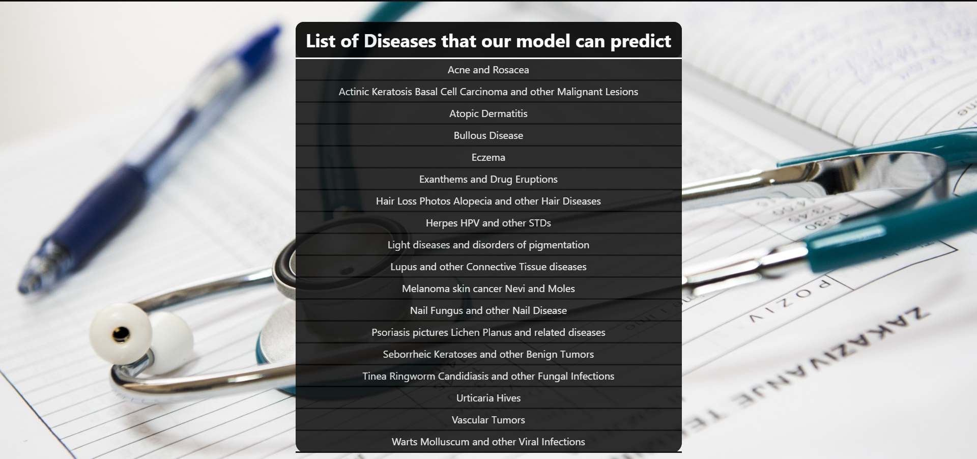
Frontend of our project
List of diseases

Slide 9
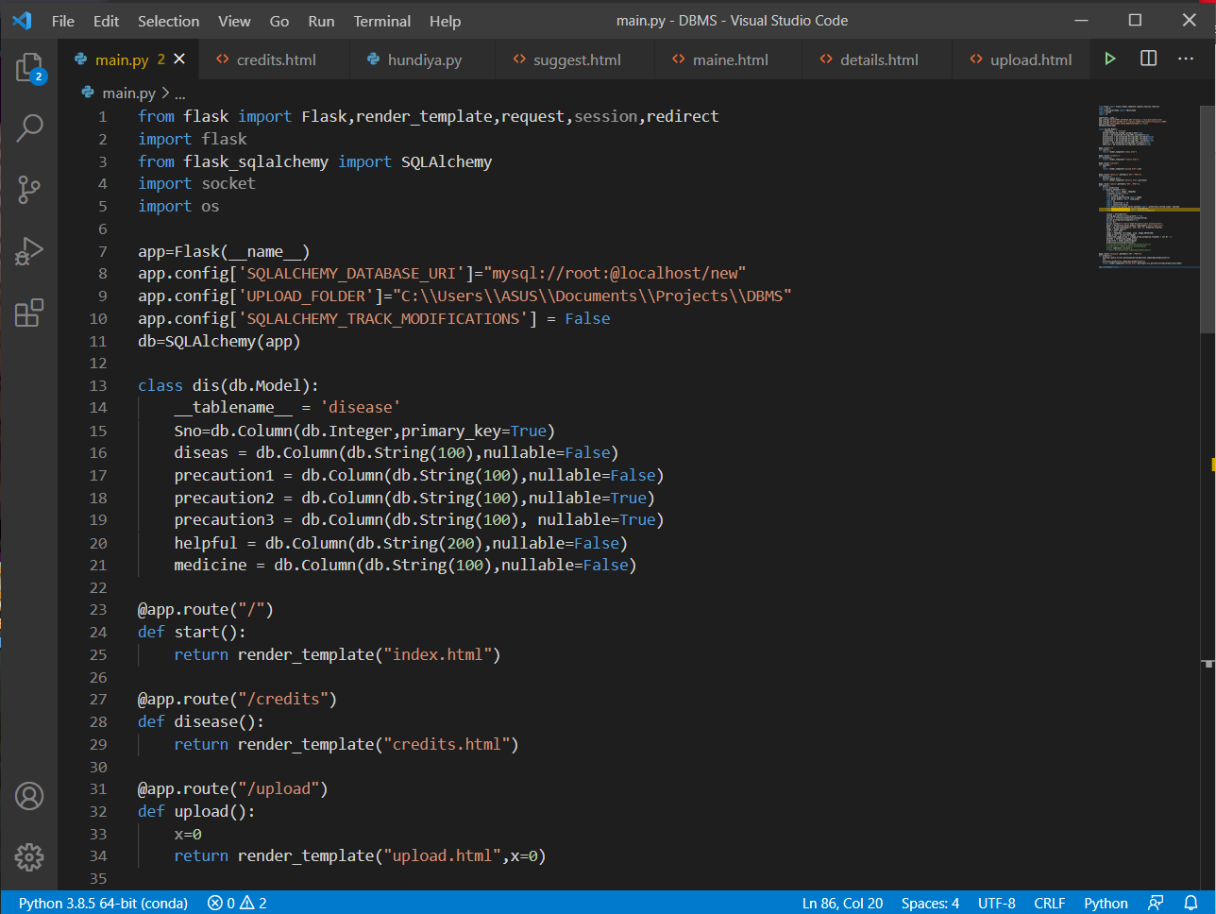

Python - Flask
Flask is Python framework or module for backend development and for web applications.

Slide 10
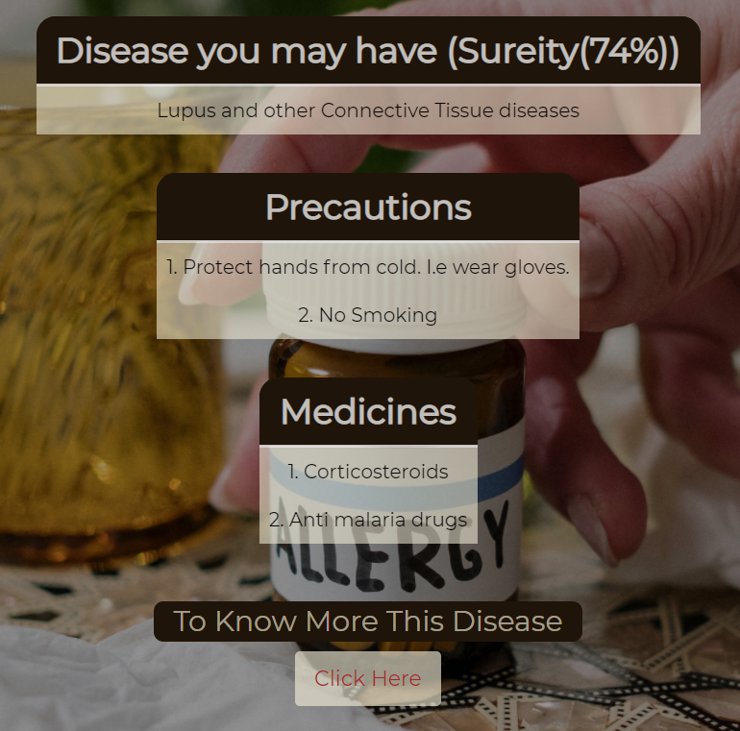
Additional Detail Database
This is the prediction page which is showing the disease name and how much percent our model is sure.
Precautions about the disease predicted by the model.
Medicines that are required to stop the disease then and there.
Another link is provided for more information

Slide 11
References
(1). Automated Skin Disease Identification using Deep Learning Algorithm
Paper by :- Sourav Kumar Patnaik, Mansher Singh Sidhu, Yaagyanika Gehlot, Bhairvi Sharma and P Muthu
Available :- “ https://biomedpharmajournal.org/vol11no3/automated-skin-disease-identification-using-deep-learning-algorithm/ ”
(2). Network In Network
Paper by :- Min Lin, Qiang Chen, Shuicheng Yan
Available :- “https://arxiv.org/abs/1312.4400”
(3). Convolutional Neural Network
Paper by :- iuxiang Gu , Zhenhua Wang, Jason Kuen, Lianyang Ma, Amir Shahroudy, Bing Shuai, Ting Liu, Xingxing Wang, Li Wang, Gang Wang, Jianfei Cai, Tsuhan Chen
Available :- “https://arxiv.org/pdf/1512.07108.pdf”

Slide 12

Thank You
April Hansson
Tushar kumar
2K19/CO/413
Tanmay Gupta
2K19/CO/406

